Slide 1
Chapter Ten
The Internet
Data Communications and Computer Networks: A Business User’s Approach
Eighth Edition

Slide 2
After reading this chapter, you should be able to:
Discuss the responsibilities of the Internet Protocol (IP) and how IP can be used to create a connection between networks
Identify both IPv4 and IPv6 addresses
Discuss the responsibilities of the Transmission Control Protocol (TCP) and how it can be used to create a reliable, end-to-end network connection
Data Communications and Computer Networks: A Business User's Approach, Eighth Edition
© 2016. Cengage Learning. All Rights Reserved.

Slide 3
After reading this chapter, you should be able to (continued):
Identify the relationships between TCP/IP and the protocols ICMP, UDP, ARP, DHCP, NAT, and tunneling protocols
Describe the responsibility of the Domain Name System and how it converts a URL into a dotted decimal IP address
Data Communications and Computer Networks: A Business User's Approach, Eighth Edition
© 2016. Cengage Learning. All Rights Reserved.

Slide 4
After reading this chapter, you should be able to (continued):
Describe the major Internet applications and services
Recognize that the Internet is constantly evolving and that IPv6 and Internet2 demonstrate that evolution
Data Communications and Computer Networks: A Business User's Approach, Eighth Edition
© 2016. Cengage Learning. All Rights Reserved.

Slide 5
Introduction
Today’s present Internet is a vast collection of thousands of networks and their attached devices
The Internet began as ARPANET during the 1960s
One high-speed backbone connected several university, government, and research sites
  Backbone was capable of supporting 56 kbps transmission speeds and eventually became financed by the National Science Foundation (NSF)
Data Communications and Computer Networks: A Business User's Approach, Eighth Edition
© 2016. Cengage Learning. All Rights Reserved.

Slide 6
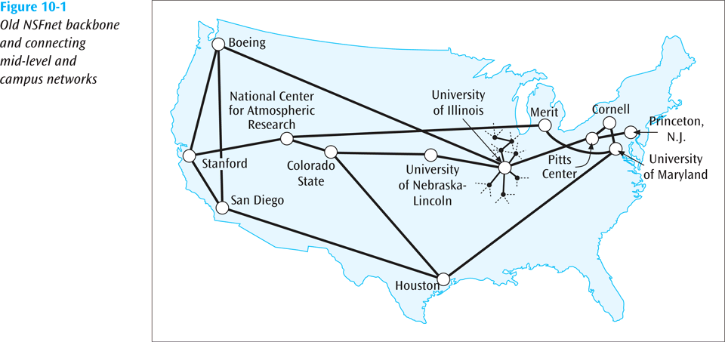
Introduction (continued)
Data Communications and Computer Networks: A Business User's Approach, Eighth Edition
© 2016. Cengage Learning. All Rights Reserved.

Slide 7
Internet Protocols
To support the Internet and all its services, many protocols are necessary
Some of the protocols that we will look at:
  Internet Protocol (IP)
  Transmission Control Protocol (TCP)
  Address Resolution Protocol (ARP)
  Dynamic Host Configuration Protocol (DHCP)
  Network Address Translation (NAT)
Data Communications and Computer Networks: A Business User's Approach, Eighth Edition
© 2016. Cengage Learning. All Rights Reserved.

Slide 8
Internet Protocols (continued)
Recall that the Internet with all its protocols follows the TCP/IP protocol suite (Internet model)
  An application, such as e-mail, resides at the highest layer
  A transport protocol, such as TCP, resides at the transport layer
  The Internet Protocol (IP) resides at the Internet or network layer
  A particular media and its framing resides at the network access (or data link) layer
Data Communications and Computer Networks: A Business User's Approach, Eighth Edition
© 2016. Cengage Learning. All Rights Reserved.

Slide 9
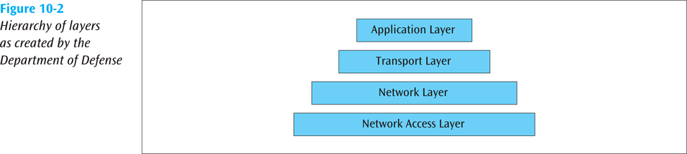
Internet Protocols (continued)
Data Communications and Computer Networks: A Business User's Approach, Eighth Edition
© 2016. Cengage Learning. All Rights Reserved.

Slide 10
The Internet Protocol (IP)
IP prepares a packet for transmission across the Internet
The IP header is encapsulated onto a transport data packet
The IP packet is then passed to the next layer where further network information is encapsulated onto it
Data Communications and Computer Networks: A Business User's Approach, Eighth Edition
© 2016. Cengage Learning. All Rights Reserved.

Slide 11
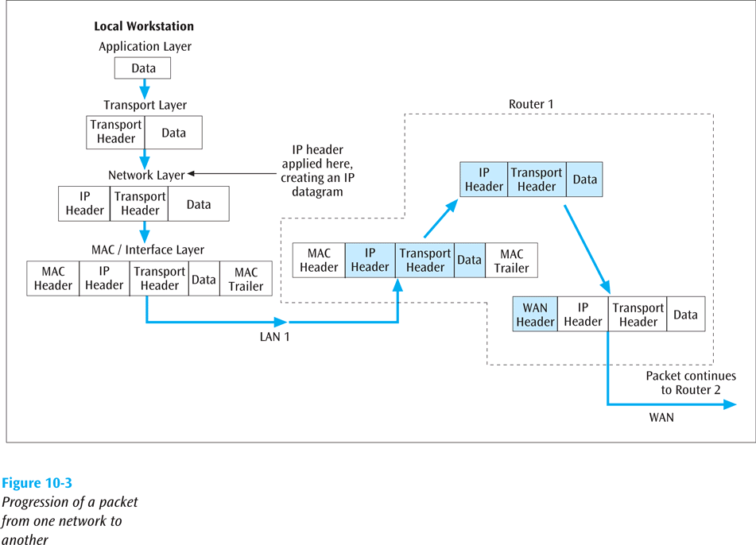
The Internet Protocol (IP) (continued)
Data Communications and Computer Networks: A Business User's Approach, Eighth Edition
© 2016. Cengage Learning. All Rights Reserved.

Slide 12
The Internet Protocol (IP) (continued)
There are currently two versions of IP:
  Version 4, which has been in existence for many years
  Version 6, which has been available for several years but is only now starting to see a substantial move towards replacing version 4
  Let’s take a look at both versions
Data Communications and Computer Networks: A Business User's Approach, Eighth Edition
© 2016. Cengage Learning. All Rights Reserved.

Slide 13
IPv4
Using IPv4, a router:
  Makes routing decisions based on the 32-bit destination address
  May have to fragment the datagram into smaller datagrams using Fragment Offset
  May determine that current datagram has been hopping around the network too long and delete it (Time to Live)
Data Communications and Computer Networks: A Business User's Approach, Eighth Edition
© 2016. Cengage Learning. All Rights Reserved.

Slide 14
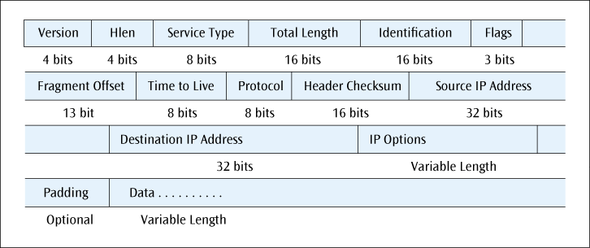
The IPv4 Header/Datagram
Figure 10-4
Format of the IPv4 datagram
Data Communications and Computer Networks: A Business User's Approach, Eighth Edition
© 2016. Cengage Learning. All Rights Reserved.

Slide 15
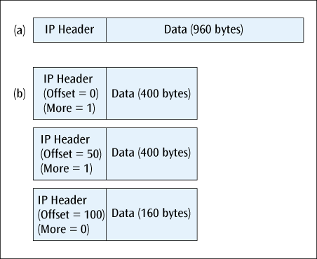
IPv4
Fragmenting an IPv4 datagram is performed by the Offset and More fields. Offset value is in multiples of 8 bytes
Figure 10-5
Division of an IPv4 datagram into three fragments
Data Communications and Computer Networks: A Business User's Approach, Eighth Edition
© 2016. Cengage Learning. All Rights Reserved.

Slide 16
IPv4 Addresses
All devices connected to Internet have a 32-bit IP address
Think of the IP address as a logical address (possibly temporary), while the 48-bit address on every NIC is the physical, or permanent address
Computers, networks and routers use the 32-bit binary address, but a more readable form is the dotted decimal notation
Data Communications and Computer Networks: A Business User's Approach, Eighth Edition
© 2016. Cengage Learning. All Rights Reserved.

Slide 17
IPv4 Addresses (continued)
For example, the 32-bit binary address
10000000 10011100 00001110 00000111
translates to
128.156.14.7
in dotted decimal notation
Data Communications and Computer Networks: A Business User's Approach, Eighth Edition
© 2016. Cengage Learning. All Rights Reserved.

Slide 18
IPv4 Addresses (continued)
When IP addresses were originally created, they were called classful addresses
  That is, each IP address fell into particular class
  A particular class address has a unique network address size and a unique host address size
  There are basically five types of IP addresses: Classes A, B, C, D and E
Data Communications and Computer Networks: A Business User's Approach, Eighth Edition
© 2016. Cengage Learning. All Rights Reserved.

Slide 19
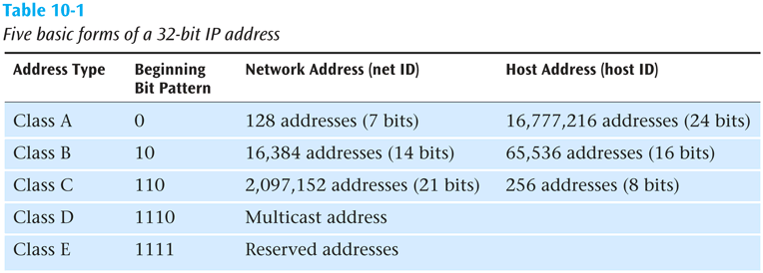
IPv4 Addresses (continued)
Data Communications and Computer Networks: A Business User's Approach, Eighth Edition
© 2016. Cengage Learning. All Rights Reserved.

Slide 20
IPv4 Addresses (continued)
When you examine the first decimal value in the dotted decimal notation:
  All Class A addresses are in the range 0 - 127
  All Class B addresses are in the range 128 - 191
  All Class C addresses are in the range 192 – 223
  All Class D addresses are in the range 224 – 239
  All Class E addresses are in the range 240 - 255
Data Communications and Computer Networks: A Business User's Approach, Eighth Edition
© 2016. Cengage Learning. All Rights Reserved.

Slide 21
IPv4 Addresses (continued)
IP subnet masking
  Sometimes you have a large number of IP addresses to manage
  By using subnet masking, you can break the host ID portion of the address into a subnet ID and host ID
  Example – subnet mask 255.255.255.0 applied to a class B address will break the host ID (normally 16 bits) into an 8-bit subnet ID and an 8-bit host ID
Data Communications and Computer Networks: A Business User's Approach, Eighth Edition
© 2016. Cengage Learning. All Rights Reserved.

Slide 22
IPv4 Addresses (continued)
Today, IP addresses are considered classless addresses
  With classless addressing, companies (users) do not apply for particular class of addresses
    Instead, company will get its IP addresses from an Internet service provider (ISP)
    Most ISPs have already applied for a large number of IP addresses and are willing to lease those addresses to companies
Data Communications and Computer Networks: A Business User's Approach, Eighth Edition
© 2016. Cengage Learning. All Rights Reserved.

Slide 23
IPv4 Addresses (continued)
Example – instead of applying for two Class C addresses, a company could contact an ISP, which would lease 500 IP addresses to the company
The addresses are not identified by any class – they are simply a contiguous block of IP addresses
Classless addressing has led to a much more efficient allocation of the IP address space
  A company can lease only as many addresses as it needs
Data Communications and Computer Networks: A Business User's Approach, Eighth Edition
© 2016. Cengage Learning. All Rights Reserved.

Slide 24
Classless IPv4 Addresses
An IP address in slash notation has all the info we need about the block of addresses assigned to a user/company
For example, one address in a block of addresses is 167.199.170.82/27
  27 bits belong to the network ID, and 5 bits belong to the host ID (IPv4 addresses have 32 bits)
  The network mask has 27 1s followed by 5 0s. In dotted decimal notation that is 255.255.255.224.
  The number of addresses in the block is 2⁵ = 32
Data Communications and Computer Networks: A Business User's Approach, Eighth Edition
© 2016. Cengage Learning. All Rights Reserved.

Slide 25
Classless IPv4 Addresses
To find the first address, AND the address (167.199.170.82) with the network mask (255.255.255.224)
Address: 10100111 11000111 10101010 01010010
Mask: 11111111 11111111 11111111 11100000
Result: 10100111 11000111 10101010 01000000
Which in decimal is 167.199.170.64/27
The last address is 31 addresses past the first, or 167.199.170.95/27
Data Communications and Computer Networks: A Business User's Approach, Eighth Edition
© 2016. Cengage Learning. All Rights Reserved.

Slide 26
IPv6
The next version of the Internet Protocol
Main features include:
  Simpler header
  128-bit IP addresses
  Priority levels and quality of service parameters
  No fragmentation
Data Communications and Computer Networks: A Business User's Approach, Eighth Edition
© 2016. Cengage Learning. All Rights Reserved.

Slide 27
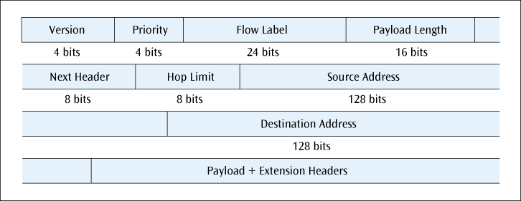
IPv6 (continued)
Figure 10-6
The fields in the IPv6 header
Data Communications and Computer Networks: A Business User's Approach, Eighth Edition
© 2016. Cengage Learning. All Rights Reserved.

Slide 28
IPv6 Addresses
IPv6 addresses are 128-bits in size (2¹²⁸ is a very large number!)
They are also classless addresses, similar to IPv4 addresses
Because of their size, a number of conventions have been adopted:
Data Communications and Computer Networks: A Business User's Approach, Eighth Edition
© 2016. Cengage Learning. All Rights Reserved.

Slide 29
IPv6 Addresses
Binary addresses are written using the short-hand hexadecimal form:
0110 1010 0011 1110 1011 1010 … 1110 1111
6A3E : BA91 : 7221 : 0000 : 01FC : 922C : 877B : FFEF
Four hex 0s in a row are truncated as follows:
6A3E : BA91 : 7221 : 0 : 01FC : 922C : 877B : FFEF
Data Communications and Computer Networks: A Business User's Approach, Eighth Edition
© 2016. Cengage Learning. All Rights Reserved.

Slide 30
IPv6 Addresses
Longer strings of 0s can be abbreviated further. For example,
6A3E : BA91 : 0 : 0 : 0 : 0 : 877B : FFEF
can be abbreviated as
6A3E : BA91 : : 877B : FFEF
Data Communications and Computer Networks: A Business User's Approach, Eighth Edition
© 2016. Cengage Learning. All Rights Reserved.

Slide 31
The Transmission Control Protocol (TCP)
TCP layer creates connection between sender and receiver using port numbers
  The port number identifies a particular application on a particular device (IP address)
TCP can multiplex multiple connections (using port numbers) over a single IP line
Data Communications and Computer Networks: A Business User's Approach, Eighth Edition
© 2016. Cengage Learning. All Rights Reserved.

Slide 32
The Transmission Control Protocol (TCP) (continued)
The TCP layer can ensure that the receiver is not overrun with data (end-to-end flow control) using the Window field
TCP can perform end-to-end error correction
  Checksum
TCP allows for the sending of high priority data
  Urgent Pointer
Data Communications and Computer Networks: A Business User's Approach, Eighth Edition
© 2016. Cengage Learning. All Rights Reserved.

Slide 33
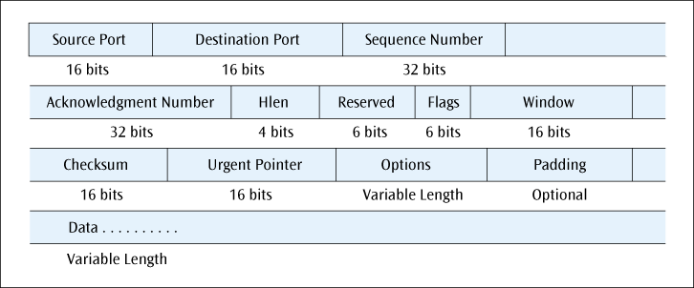
The Transmission Control Protocol (TCP) (continued)
Figure 10-7
The fields of the TCP header
Data Communications and Computer Networks: A Business User's Approach, Eighth Edition
© 2016. Cengage Learning. All Rights Reserved.

Slide 34
Internet Control Message Protocol (ICMP)
ICMP
  Used by routers and nodes
  Performs error reporting for the Internet Protocol
    ICMP reports errors such as invalid IP address, invalid port address, and the packet has hopped too many times
Data Communications and Computer Networks: A Business User's Approach, Eighth Edition
© 2016. Cengage Learning. All Rights Reserved.

Slide 35
User Datagram Protocol (UDP)
A transport layer protocol used in place of TCP
Where TCP supports a connection-oriented application, UDP is used with connectionless applications
UDP also encapsulates a header onto an application packet but the header is much simpler than TCP (16-bit source port, 16-bit dest port, 16-bit length of entire packet, 16-bit checksum)
Data Communications and Computer Networks: A Business User's Approach, Eighth Edition
© 2016. Cengage Learning. All Rights Reserved.

Slide 36
Multiprotocol Label Switching
An additional layer often added above TCP
Used to move Internet packets more quickly through routers
By using the MPLS label, the router does not have to “dig in” so deep to retrieve IP address
The 20-bit Label field is the key identifier that connects this packet with a particular flow of packets
Data Communications and Computer Networks: A Business User's Approach, Eighth Edition
© 2016. Cengage Learning. All Rights Reserved.

Slide 37
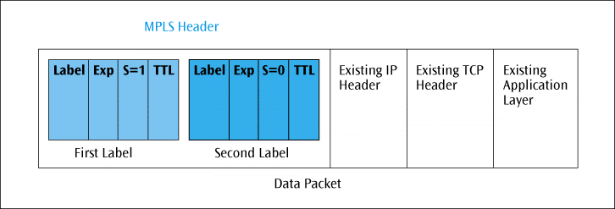
Multiprotocol Label Switching
Figure 10-8
Two MPLS headers and their four fields
Data Communications and Computer Networks: A Business User's Approach, Eighth Edition
© 2016. Cengage Learning. All Rights Reserved.

Slide 38
Address Resolution Protocol (ARP)
When an IP packet has traversed the Internet and encounters the destination LAN, how does the packet find the destination workstation?
Even though destination workstation may have an IP address, a LAN does not use IP addresses to deliver frames
  A LAN uses MAC layer address
ARP translates IP address into MAC layer address so frame can be delivered to proper workstation
Data Communications and Computer Networks: A Business User's Approach, Eighth Edition
© 2016. Cengage Learning. All Rights Reserved.

Slide 39
Dynamic Host Configuration Protocol (DHCP)
An IP address can be assigned to a workstation permanently (static assignment) or dynamically
  Dynamic IP address assignment is a more efficient use of scarce IP addresses
  When DHCP client issues an IP request, DHCP server looks in its static table
    If no entry exists, server selects an IP address from available pool
Data Communications and Computer Networks: A Business User's Approach, Eighth Edition
© 2016. Cengage Learning. All Rights Reserved.

Slide 40
Dynamic Host Configuration Protocol (DHCP) (continued)
The address assigned by DHCP server is temporary
  Part of agreement includes specific period of time
    If no time period specified, the default is one hour
  DHCP clients may negotiate for a renewal before the time period expires
Data Communications and Computer Networks: A Business User's Approach, Eighth Edition
© 2016. Cengage Learning. All Rights Reserved.

Slide 41
Network Address Translation (NAT)
NAT lets router represent entire local area network to Internet as single IP address
  Thus, all traffic leaving LAN appears as originating from global IP address
  All traffic coming into this LAN uses this global IP address
This security feature allows a LAN to hide all the workstation IP addresses from the Internet
Data Communications and Computer Networks: A Business User's Approach, Eighth Edition
© 2016. Cengage Learning. All Rights Reserved.

Slide 42
Network Address Translation (NAT) (continued)
Since the outside world cannot see into LAN, you do not need to use registered IP addresses on inside LAN
We can use the following blocks of addresses for private use:
  10.0.0.0 – 10.255.255.255
  172.16.0.0 – 172.31.255.255
  192.168.0.0 – 192.168.255.255
Data Communications and Computer Networks: A Business User's Approach, Eighth Edition
© 2016. Cengage Learning. All Rights Reserved.

Slide 43
Network Address Translation (NAT) (continued)
When a user on inside sends packet to outside, the NAT interface changes the user’s inside address to global IP address
  This change is stored in a cache
When the response comes back, the NAT looks in cache and switches the addresses back
  If not the packet is dropped
    Unless NAT has a service table of fixed IP address mappings
      This service table allows packets to originate from the outside
Data Communications and Computer Networks: A Business User's Approach, Eighth Edition
© 2016. Cengage Learning. All Rights Reserved.

Slide 44
Tunneling Protocols and Virtual Private Networks (VPNs)
The Internet is not normally a secure system
If person wants to use Internet to access corporate computer system, how can a secure connection be created?
  One possible technique is by creating a virtual private network (VPN)
    VPN creates a secure connection through the Internet by using a tunneling protocol
Data Communications and Computer Networks: A Business User's Approach, Eighth Edition
© 2016. Cengage Learning. All Rights Reserved.

Slide 45
The World Wide Web
The World Wide Web (WWW) – immense collection of web pages and other resources that can be downloaded across the Internet and displayed on a workstation via a web browser and is the most popular service on the Internet
Basic web pages are created with the Hypertext Markup Language (HTML)
Hypertext Transport Protocol (HTTP) is protocol to transfer a web page
Data Communications and Computer Networks: A Business User's Approach, Eighth Edition
© 2016. Cengage Learning. All Rights Reserved.

Slide 46
Locating a Document on the Internet
Every document on the Internet has a unique Uniform Resource Locator (URL)
All URLs consist of four parts:
  Service type
  Host or domain name
  Directory or subdirectory information
  Filename
Data Communications and Computer Networks: A Business User's Approach, Eighth Edition
© 2016. Cengage Learning. All Rights Reserved.

Slide 47
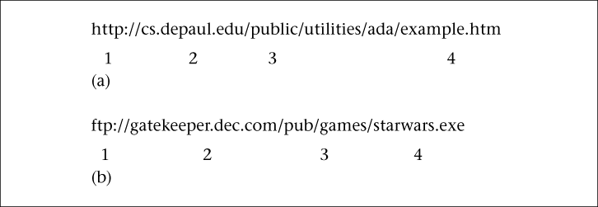
Locating a Document on the Internet (continued)
Figure 10-9
The parts of a Uniform Resource Locator (URL) for HTTP (a) and FTP (b)
Data Communications and Computer Networks: A Business User's Approach, Eighth Edition
© 2016. Cengage Learning. All Rights Reserved.

Slide 48
Locating a Document on the Internet (continued)
When a user, running a Web browser, enters a URL, how is URL translated into an IP address?
  Domain Name System (DNS) – large, distributed database of URLs and IP addresses
    The first operation performed by DNS is to query a local database for URL/IP address information
      If local server does not recognize address, the server at next level will be queried
      Eventually root server for URL/IP addresses will be queried
        If root server has answer, results are returned
        If root server recognizes domain name but not extension in front of domain name, root server will query server at domain name’s location
        When domain’s server returns results, they are passed back through chain of servers (and their caches)
Data Communications and Computer Networks: A Business User's Approach, Eighth Edition
© 2016. Cengage Learning. All Rights Reserved.

Slide 49
Internet Services
The Internet provides many types of services, including several very common ones:
  Electronic mail (e-mail)
  File transfer protocol (FTP)
  Remote login (Telnet)
  VoIP (Voice over IP)
  Listservs
  Streaming audio and video
  Instant Messaging, Tweets, and Blogs
Data Communications and Computer Networks: A Business User's Approach, Eighth Edition
© 2016. Cengage Learning. All Rights Reserved.

Slide 50
Electronic Mail (e-mail)
E-mail programs can create, send, receive, and store e-mails, as well as reply to, forward, and attach non-text files
Multipurpose Internet Mail Extension (MIME) is used to send e-mail attachments
Simple Mail Transfer Protocol (SMTP) is used to transmit e-mail messages
Post Office Protocol version 3 (POP3) and Internet Message Access Protocol (IMAP) are used to hold and later retrieve e-mail messages
Data Communications and Computer Networks: A Business User's Approach, Eighth Edition
© 2016. Cengage Learning. All Rights Reserved.

Slide 51
File Transfer Protocol (FTP)
Used to transfer files across the Internet
User can upload or download a file
The URL for an FTP site begins with ftp://…
The three most common ways to access an FTP site are:
  Through a browser
  Using a canned FTP program
  Issuing FTP commands at a text-based command prompt
Data Communications and Computer Networks: A Business User's Approach, Eighth Edition
© 2016. Cengage Learning. All Rights Reserved.

Slide 52
Remote Login (Telnet)
Allows a user to remotely log in to a distant computer site
User usually needs a login and password to access a remote computer site
User saves money on long-distance telephone charges
Data Communications and Computer Networks: A Business User's Approach, Eighth Edition
© 2016. Cengage Learning. All Rights Reserved.

Slide 53
Voice Over IP (VoIP)
The transfer of voice signals using a packet-switched network and the IP protocol
Voice over IP (VoIP) can be internal to a company (private VoIP) or can be external using the Internet
VoIP consumes many resources and may not always work well, but can be cost-effective in certain situations
Data Communications and Computer Networks: A Business User's Approach, Eighth Edition
© 2016. Cengage Learning. All Rights Reserved.

Slide 54
Voice Over IP (continued)
Three basic ways to make a telephone call using VoIP:
  PC to PC using sound cards and headsets (or speakers and microphone)
  PC to telephone (need a gateway to convert IP addresses to telephone numbers)
  Telephone to telephone (need gateways)
Data Communications and Computer Networks: A Business User's Approach, Eighth Edition
© 2016. Cengage Learning. All Rights Reserved.

Slide 55
Voice Over IP (continued)
Three functions necessary to support VoIP:
  Voice must be digitized (PCM, 64 kbps, fairly standard)
  64 kbps voice must be compressed
  Once the voice is compressed, the data must be transmitted
Data Communications and Computer Networks: A Business User's Approach, Eighth Edition
© 2016. Cengage Learning. All Rights Reserved.

Slide 56
Voice Over IP (continued)
How can we transport compressed voice?
  H.323
    Created in 1996 by ITU-T
    Actually, H.323 created for a wide range of applications both audio and video, and not for TCP/IP networks
  Session Initiation Protocol (SIP)
    Created by IETF specifically for supporting the transfer of voice over the Internet
  Many feel SIP will surpass H.323
Data Communications and Computer Networks: A Business User's Approach, Eighth Edition
© 2016. Cengage Learning. All Rights Reserved.

Slide 57
Voice Over IP (continued)
ENUM
  A protocol that supports VoIP
  Converts telephone numbers to fully qualified domain name addresses
  Example – telephone number (312) 555-1212 will be converted to 2.1.2.1.5.5.5.2.1.3.1.e164.arpa
Data Communications and Computer Networks: A Business User's Approach, Eighth Edition
© 2016. Cengage Learning. All Rights Reserved.

Slide 58
Listservs
A popular software program used to create and manage Internet mailing lists
When an individual sends an e-mail to a listserv, the listserv sends a copy of the message to all listserv members
Listservs can be useful business tools for individuals trying to follow a particular area of study
Data Communications and Computer Networks: A Business User's Approach, Eighth Edition
© 2016. Cengage Learning. All Rights Reserved.

Slide 59
Streaming Audio and Video
The continuous download of a compressed audio or video file, which can be heard or viewed on the user’s workstation
Real-Time Protocol (RTP) and Real-Time Streaming Protocol (RTSP) support streaming audio and video
Streaming audio and video consume a large amount of network resources
Data Communications and Computer Networks: A Business User's Approach, Eighth Edition
© 2016. Cengage Learning. All Rights Reserved.

Slide 60
Instant Messaging, Tweets, and Blogs
IM allows a user to see if people are currently logged in on the network and to send short messages in real time
Consumes less resources than e-mail, and faster
Tweets occur when you Twitter. Max 140 character messages
Blogs are online web logs that people maintain
Data Communications and Computer Networks: A Business User's Approach, Eighth Edition
© 2016. Cengage Learning. All Rights Reserved.

Slide 61
The Internet and Business
E-Commerce – the buying and selling of goods and services via the Internet
Many agree that e-commerce consists of four major areas:
  E-retailing
  Electronic data interchange (EDI)
  Micro-marketing
  Internet security
Data Communications and Computer Networks: A Business User's Approach, Eighth Edition
© 2016. Cengage Learning. All Rights Reserved.

Slide 62
Cookies and State Information
A cookie is data created by a Web server that is stored on the hard drive of a user’s workstation
  This state information is used to track a user’s activity and to predict future needs
Information on previous viewing habits stored in a cookie can also be used by other Web sites to provide customized content
Many consider cookies to be an invasion of privacy
Data Communications and Computer Networks: A Business User's Approach, Eighth Edition
© 2016. Cengage Learning. All Rights Reserved.

Slide 63
Intranets and Extranets
An intranet is a TCP/IP network inside a company that allow employees to access the company’s information resources through an Internet-like interface
When an intranet is extended outside the corporate walls to include suppliers, customers, or other external agents, the intranet becomes an extranet
Data Communications and Computer Networks: A Business User's Approach, Eighth Edition
© 2016. Cengage Learning. All Rights Reserved.

Slide 64
The Future of the Internet
Various Internet committees are constantly working on new and improved protocols
Examples include:
  Internet Printing Protocol
  Internet fax
  Extensions to FTP
  Common Name Resolution Protocol
  WWW Distributed Authoring and Versioning
Data Communications and Computer Networks: A Business User's Approach, Eighth Edition
© 2016. Cengage Learning. All Rights Reserved.

Slide 65
Internet2
A new form of the Internet is being developed by a number of businesses and universities
Internet2 will support very high-speed data streams
Applications might include:
  Digital library services
  Tele-immersion
  Virtual laboratories
Data Communications and Computer Networks: A Business User's Approach, Eighth Edition
© 2016. Cengage Learning. All Rights Reserved.

Slide 66
The Internet In Action: A Company Creates a VPN
A fictitious company wants to allow 3500 of its workers to work from home
If all 3500 users used a dial-in service, the telephone costs would be very high
Data Communications and Computer Networks: A Business User's Approach, Eighth Edition
© 2016. Cengage Learning. All Rights Reserved.

Slide 67
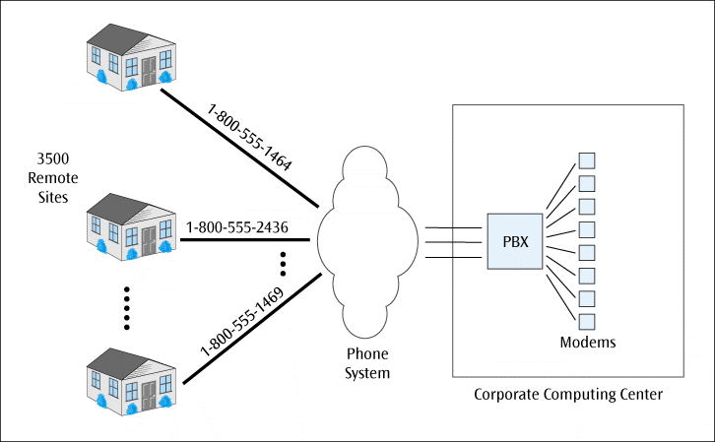
The Internet In Action: A Company Creates a VPN (continued)
Figure 10-10
CompuCom employees dialing directly into the corporate computing center
Data Communications and Computer Networks: A Business User's Approach, Eighth Edition
© 2016. Cengage Learning. All Rights Reserved.

Slide 68
The Internet In Action: A Company Creates a VPN (continued)
Instead, the company will require each user to access the Internet via their local Internet service provider
  This local access will help keep telephone costs low
  Then, once on Internet, company will provide software to support virtual private networks
  The virtual private networks will create secure connections from the users’ homes into the corporate computer system
Data Communications and Computer Networks: A Business User's Approach, Eighth Edition
© 2016. Cengage Learning. All Rights Reserved.

Slide 69
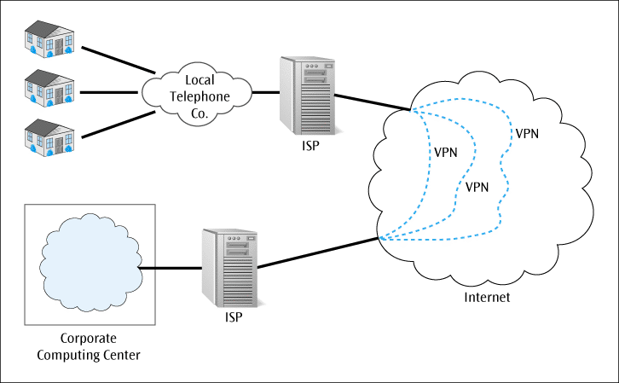
The Internet In Action: A Company Creates a VPN (continued)
Figure 10-11
CompuCom’s employees using a tunnel across the Internet into the corporate computing center
Data Communications and Computer Networks: A Business User's Approach, Eighth Edition
© 2016. Cengage Learning. All Rights Reserved.

Slide 70
Summary
To support Internet, many protocols, such as IP, TCP, ICMP, UDP, ARP, DHCP, and NAT, are necessary
The Internet Protocol provides a connectionless transfer of data over a wide variety of networks
There are currently two versions of IP: IPv4 and IPv6
The Transmission Control Protocol (TCP) resides at the transport layer and provides an error-free, end-to-end connection
The Internet Control Message Protocol (ICMP) performs error reporting for IP
Data Communications and Computer Networks: A Business User's Approach, Eighth Edition
© 2016. Cengage Learning. All Rights Reserved.

Slide 71
Summary (continued)
The User Datagram Protocol (UDP) provides a connectionless transport layer protocol in place of TCP
The Address Resolution Protocol (ARP) translates an IP address into a CSMA/CD MAC address on a LAN
The Dynamic Host Configuration Protocol (DHCP) allows a network to dynamically assign IP addresses to workstations as they are needed
Network Address Translation (NAT) allows a network to replace local IP address with on global-type IP address
Data Communications and Computer Networks: A Business User's Approach, Eighth Edition
© 2016. Cengage Learning. All Rights Reserved.

Slide 72
Summary (continued)
Tunneling protocols allow a company to create virtual private network connections into a corporate computing system
World Wide Web is vast collection of electronic documents containing text and images that can be accessed by simply clicking link within browser’s Web page
To locate document on Internet, you usually refer to its Uniform Resource Locator (URL)
Data Communications and Computer Networks: A Business User's Approach, Eighth Edition
© 2016. Cengage Learning. All Rights Reserved.

Slide 73
Summary (continued)
Internet consists of many commonly used network applications
E-commerce is the buying and selling of goods and services electronically
Cookies store state information on user’s hard drive and provide a way for Web sites to track a user’s Web-browsing patterns and preferences
Data Communications and Computer Networks: A Business User's Approach, Eighth Edition
© 2016. Cengage Learning. All Rights Reserved.

Slide 74
Summary (continued)
Intranet is in-house Internet with Web-like services that are available only to a company’s employees or to customers and suppliers through an extranet
The Internet continues to evolve with a completely new, higher-speed Internet2
Data Communications and Computer Networks: A Business User's Approach, Eighth Edition
© 2016. Cengage Learning. All Rights Reserved.

